Slide 1
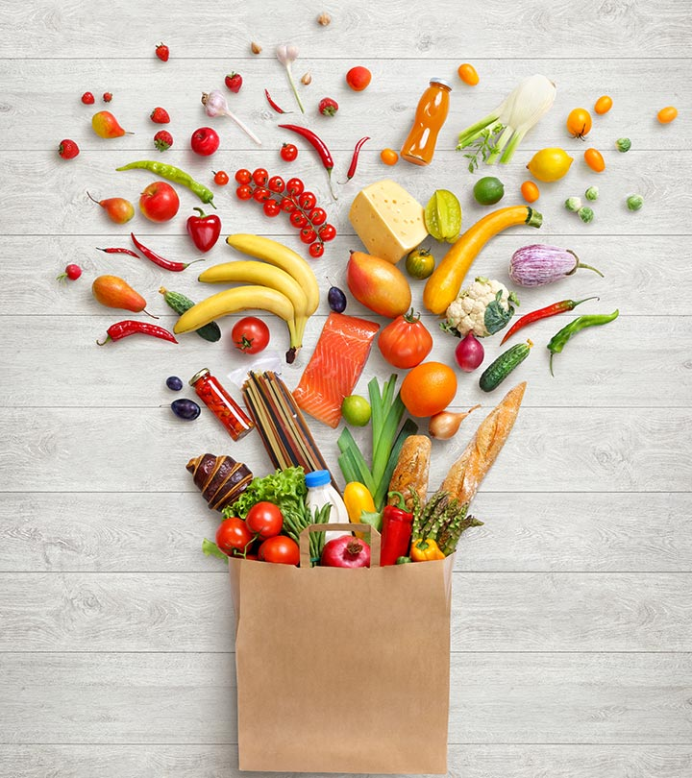
HEALTH AND LIFESTYLE CLASS – 8 NON- NURIENTS (Antioxidants, Water & Fiber)

Slide 2
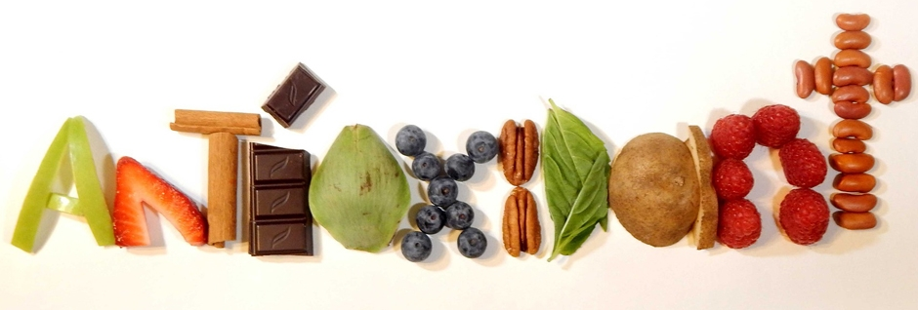
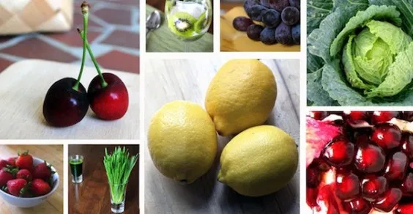
ANTIOXIDANTS
Antioxidants are substances that may protect your cells against free radicals, which prevent oxidation (loss of electrons which can produce free radicals)
Antioxidants, such as vitamins C and E and Vitamin A (carotenoids), may help protect cells from damage caused by free radicals and play a role in heart disease, cancer and other diseases.
Antioxidants boost the immune system
Oxidation causes loss of flavour and colour in foods

Slide 3

WHAT IS YOUR ANSWER ????
1. NAME SOME ANTIOXIDNAT RICH FOODS….
2. NAME SOME ANTIOXIDANTS YOU KNOW AND THEIR BENEFITS……

Slide 4
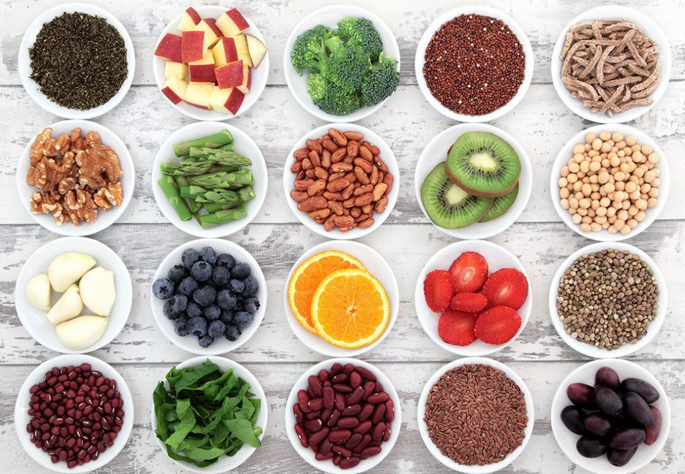
SOURCE OF ANTIOXIDANTS
Fruits, vegetables and Grain rich in dietary antioxidants provide a better way to boost antioxidant intake.
Antioxidants are found in many foods, including fruits and vegetables. They are also available as dietary supplements.
Examples of antioxidants include
Beta-carotene
Lutein
Lycopene
Selenium
Vitamin A
Vitamin C
Vitamin E

Slide 5
Phytochemicals as Antioxidants
Allium sulphur compounds – onions and garlic
Anthocyanins – eggplant, grapes and berries
Beta-carotene – pumpkin, mangoes, apricots, carrots, spinach
Catechins – Red wine and tea
Cryptoxanthins – Red capsicum, pumpkin and mangoes
Flavonoids – Tea, green tea, citrus fruits, red wine, onion and apples
Indoles – cruciferous vegetables such as broccoli, cabbage and cauliflower
Isoflavonoids – soybeans, tofu, lentils, peas and milk
Lignans – sesame seeds, bran, whole grains and vegetables
Lutein – green, leafy vegetables like spinach, and corn
Lycopene – Tomatoes, pink grapefruit and watermelon
Polyphenols – Herbs like Oregano

Slide 6
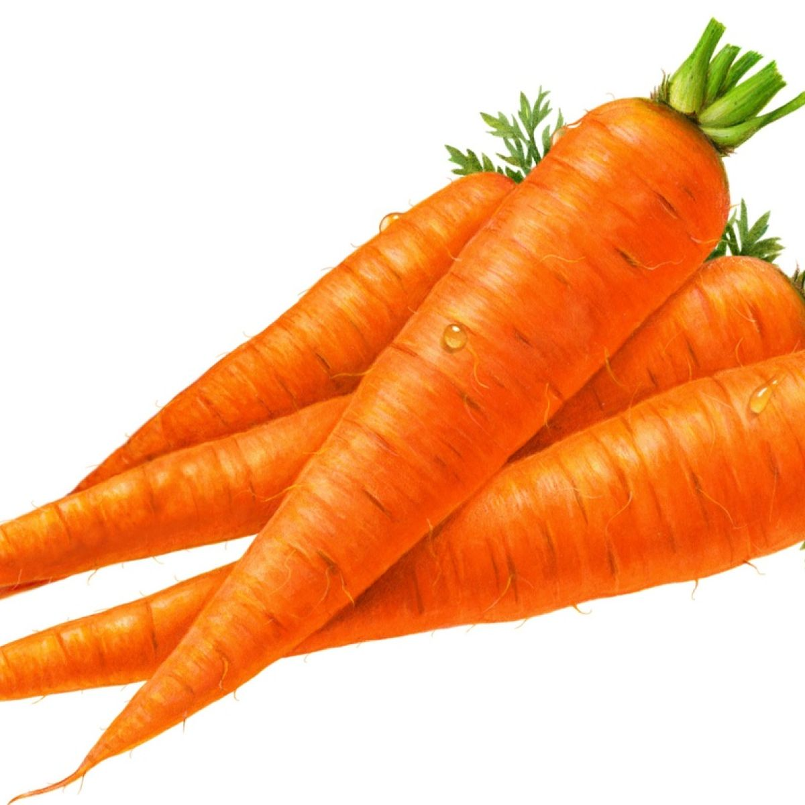
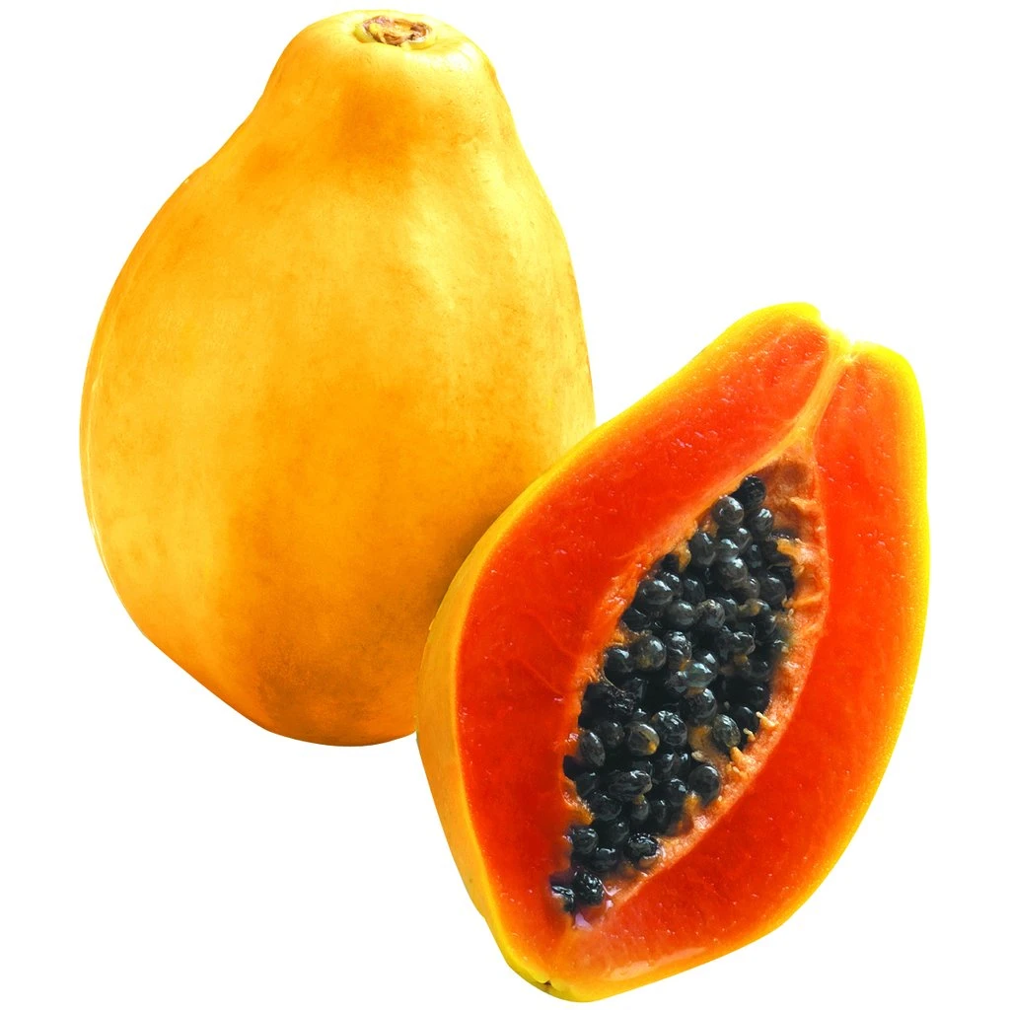
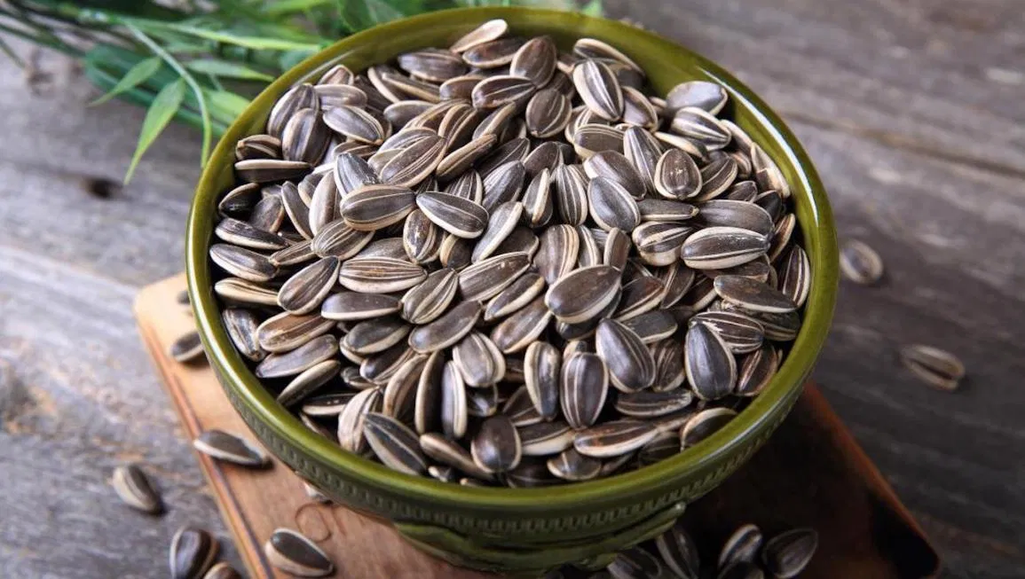
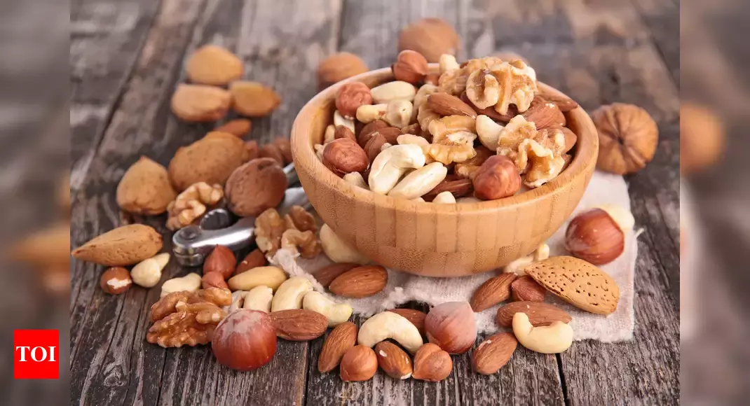
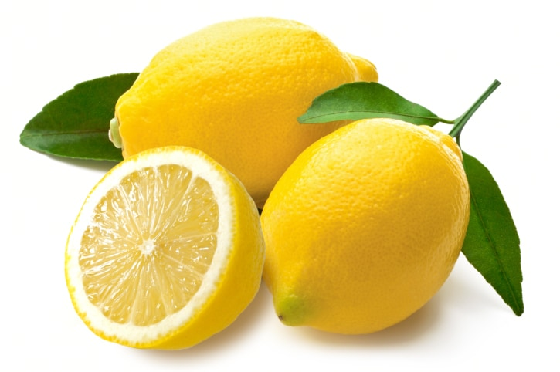
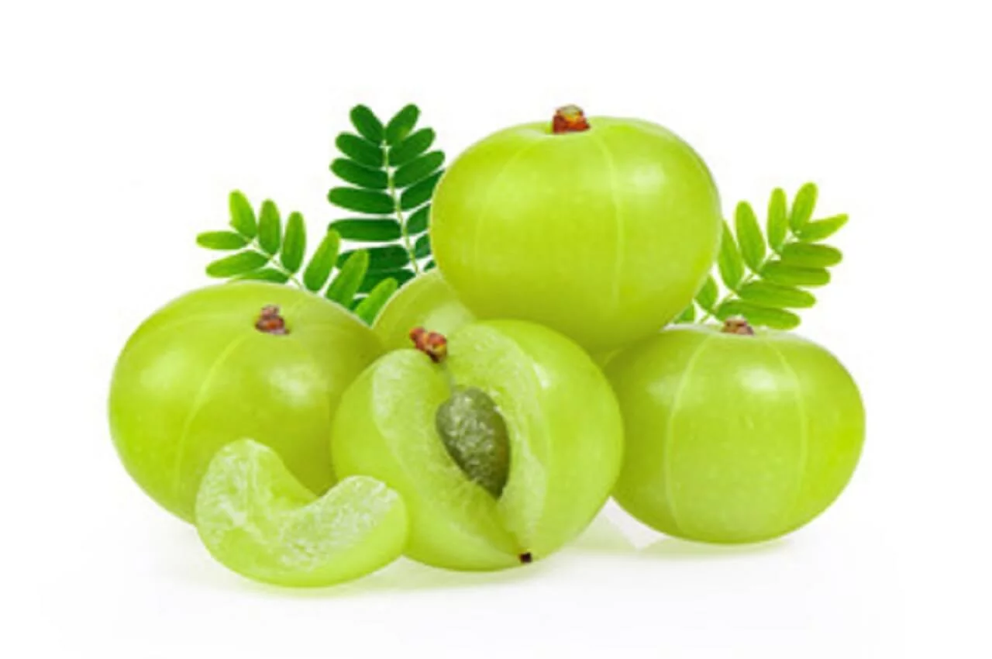
Vitamins as antioxidants
Vitamin A (Carotenoids): It is one of the vital antioxidant for general health and well being.
It is an antiaging nutrient which plays a vital role in improving immune function, cancer and heart disease.
Vitamin E (Tocopherol): It is an antioxidant present in cellular membranes and protects against lipid peroxidation and ageing process.
Vitamin C (Ascorbic acid): It is a hydrophilic antioxidant maintaining collagen in skin, repair damaged tissue, healthy teeth and bone and boost immune system

Slide 7
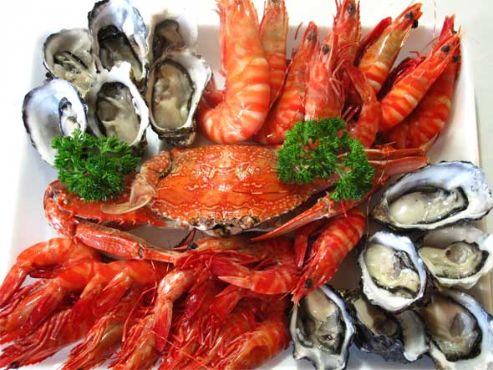
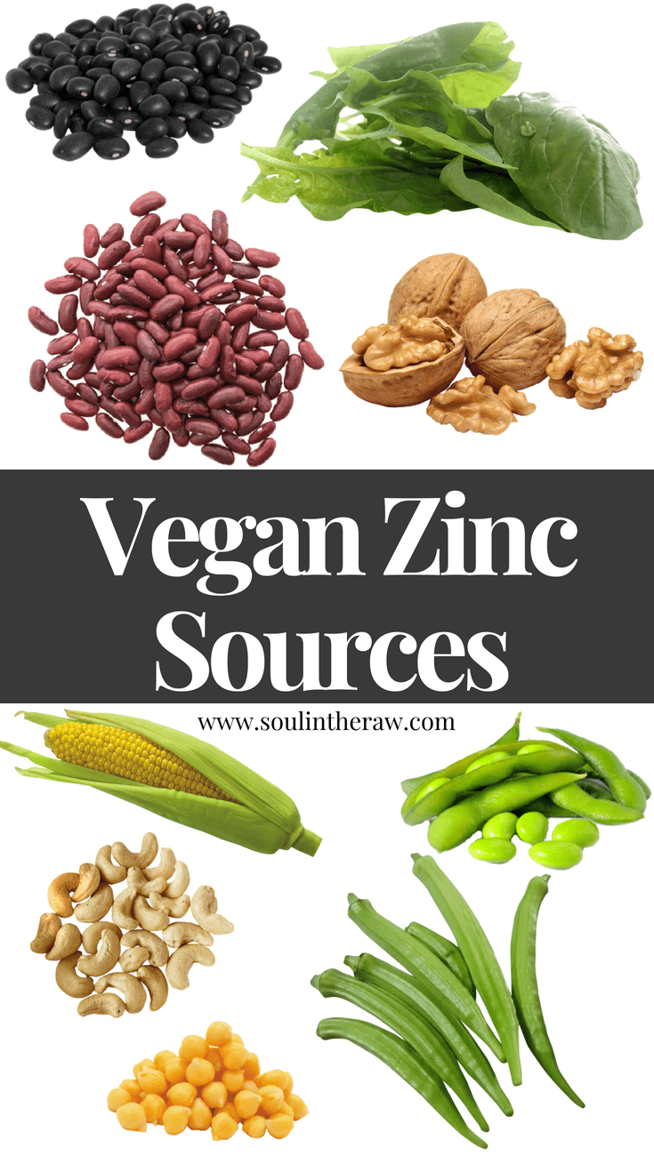
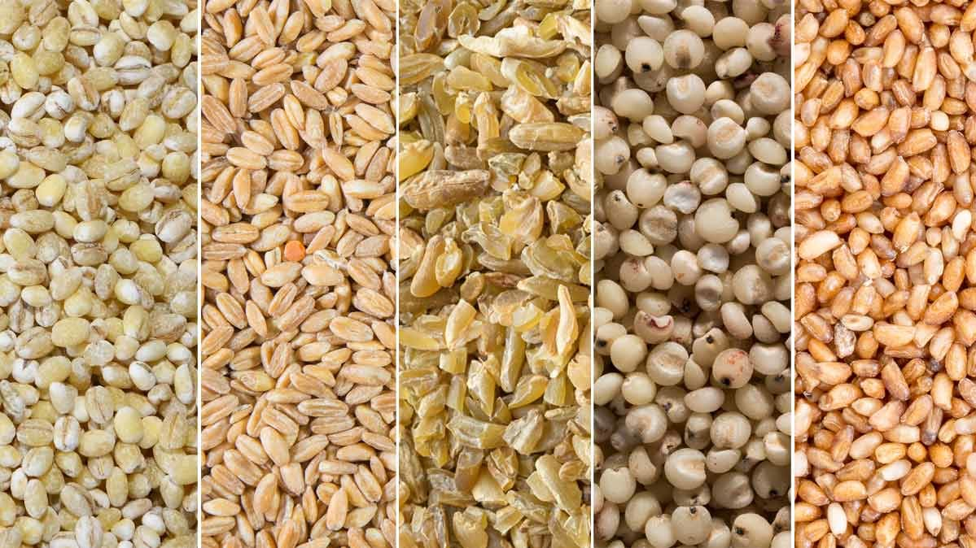
MINERALS AS ANTIOXIDANTS
ZINC and SELENIUM: It is an essential trace element and is proved to be antioxidant
It works with Vit –E in fighting free radicals
It is required for the functioning of an important enzyme Glutathione peroxidase
Selenium protects the body from free radical damage
Sources : Sea foods, meats, organ meats, whole grains.

Slide 8
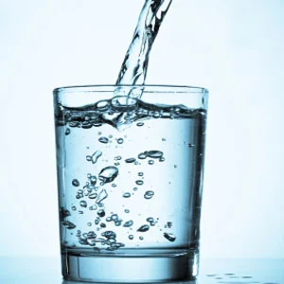
WATER
Water is an essential nutrient and plays a key role in the human body.
The human body is made up of approximately 60% water, the brain is 75% water and our blood is 83%.
The human body cannot store water.
Every day we are constantly losing water though breathing, sweating and through the release of urine and faeces.
Daily intake of water is 2 to 3 lits or 7 to 8 glasses per day.

Slide 9
Functions of Water
Acts as a delivery system, transporting nutrients to cells
Forms the base of many bodily fluids such as blood and saliva
Helps regulate body temperature
Forms fluid surrounding joints and acts as cushion between joints
Needed for digestion, softening and dissolving food components
Essential for normal bowel movements and preventing constipation
Keeps skin hydrated
Water flushes out toxins and waste materials via urine and sweat

Slide 10
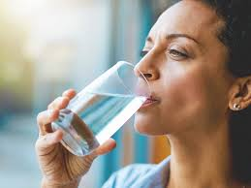
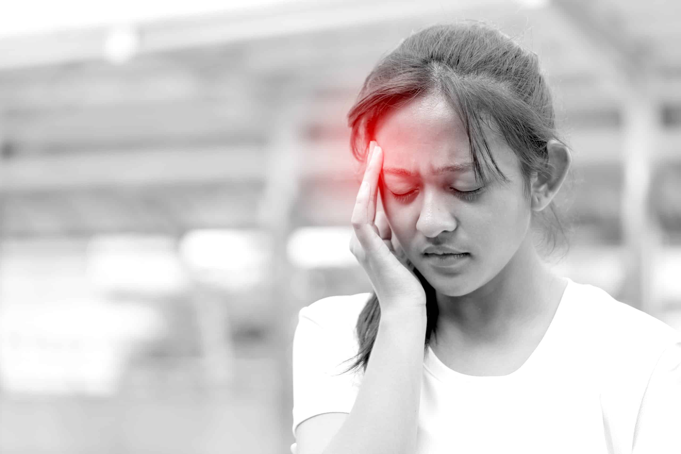


Signs of Dehydration
Dry mouth
Fatigue
Thirst
Decreased urine volume
Reduction of physical and mental performance
Headache
Dizziness

Slide 11
WHAT IS YOUR ANSWER ????
WHAT IS WATER INTOXICATION?
HOW IS DEHYDRATION CAUSED?
WHAT ARE THE SIGNS OF WATER INTOXICATON?

Slide 12
WHAT IS YOUR ANSWER ????
WHAT IS YOUR GENERAL UNDERSTANDING ON FIBER?
WHAT IS THE ROLE OF FIBER IN OUR BODY?
WHAT IS THE ROLE OF CHAPPATHIS IN WEIGHT REDUCTION?

Slide 13
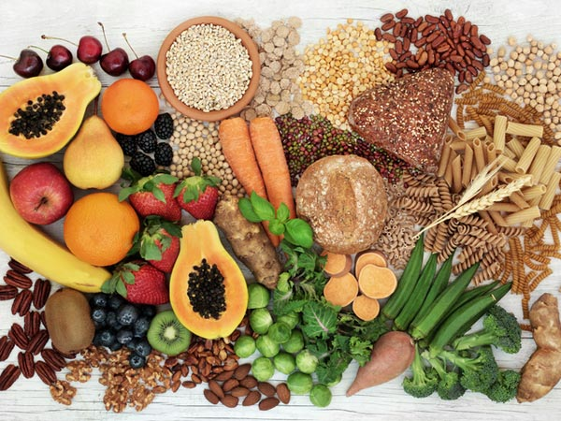
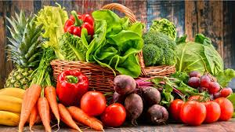
FIBER
Fiber, also known as roughage, is the part of plant-based foods
It passes through the body undigested, keeping your digestive system clean and healthy, easing bowel movements, and flushing cholesterol and harmful carcinogens out of the body.
Recommendation: 25 to 40 g of fiber per day

Slide 14
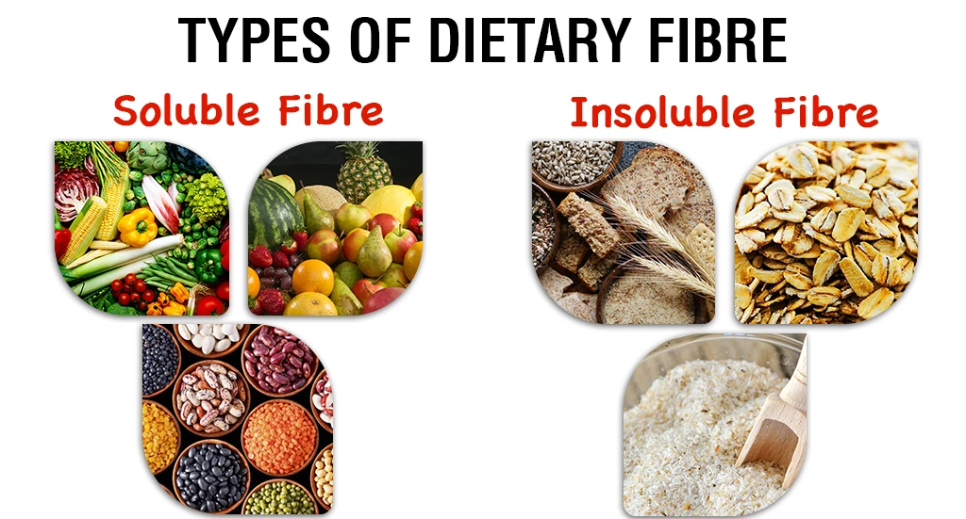
Types of Fiber
Soluble fiber
Type of fiber that attracts water and forms a gel.
This gel causes a slowing of the digestion process, which can be beneficial for weight loss.
Foods high in soluble fiber include oats, legumes, edible veggies, fruits, and nuts
Insoluble fiber
Type of fiber that, repels water.
Its primary benefit is to provide bulk to stool and aid in the movement through the digestive tract.
Insoluble fiber in foods such as nuts and seeds, wheat bran, and whole-grain foods like whole-wheat pasta and brown rice.

Slide 15
Role of fiber in the body
Fiber help you live longer.
Prevent health conditions such as prediabetes, diabetes, high cholesterol, obesity, and various digestion problems, like constipation, colon cancer, and diverticulitis,
Fiber expands and bulks food in your GI tract, slowing digestion. This can increase satisfaction of your food and helps stabilize blood sugar levels.
Higher fiber diet is associated with a lower rate of obesity.
Reduces the risk of diverticulitis, a condition in which pouches formed in the colon become infected.
There’s an anti-cancer benefit to fiber

Slide 16
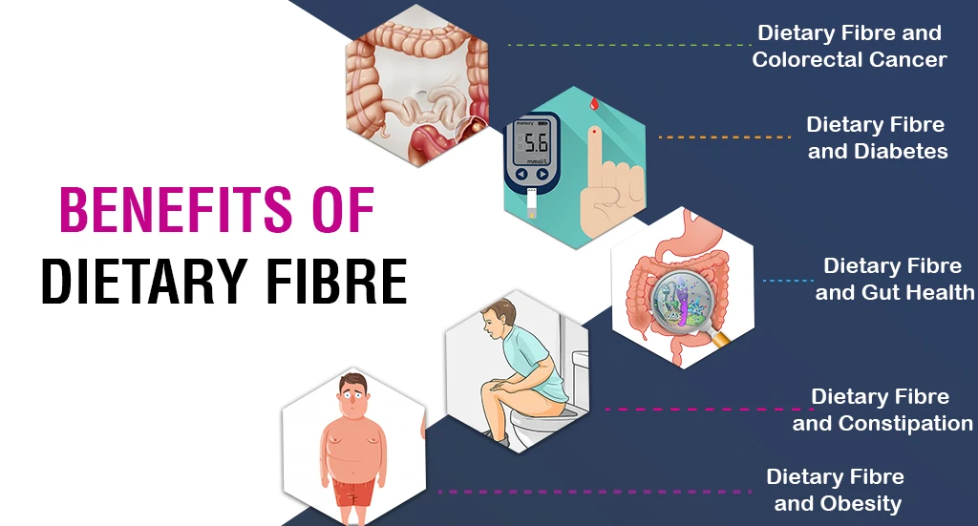

Slide 17
WHAT IS YOUR ANSWER ????
Fiber helps to reduce the risk of all of the following EXCEPT _____.
Cancer
Heart disease
Diverticulitus
Diarrhea
Diabetes
2. The severe level of dehydration in the body leads to…
Anemia
Cardiovascular disease
Hemophilia
Oesteoporosis

Slide 18
REFERENCE BOOKS
Food Science- Srilakshmi, Prosper Montague Publishing Group Ltd., Hamlyn, London. 2003.
Food & Nutrition- Swaminathan, The Bangalore Printing & publishing co ltd., Vol I, Second Edition, Bangalore (1995).
An Introduction to Lifestyle Management: Facilitator’s Handbook, Dr.Anja Morris-Paxton, 2019
DEVELOPED RESOURCE MATERIALS
ANTIOXIDANTS, WATER, FIBER- Developed PDF attached in Ample course content
LOCAL VIDEO DEVELOPED:
Video is available in Ample course content

Slide 19


